Slide 1
Equation of straight line on the plane
Some simple problems of analytical geometry:division of the piece in a given ratio.
Straight line and its general equation
A straight line equation passing through two points
Equation with the angle coefficient of a straight line.
The angle between two straight lines
Conditions of parallelism and perpendicularity of two straight lines
Distance from a point to a line and etc.

Slide 2
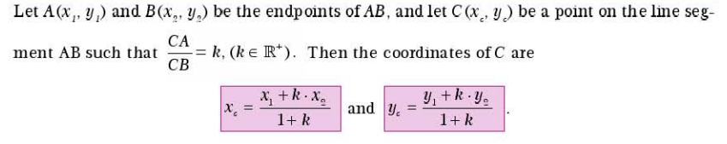
Some simple problems of analytical geometry
division of the piece in a given ratio

Slide 3
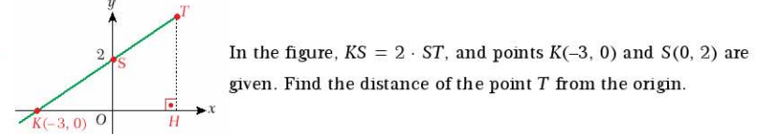
Practice

Slide 4
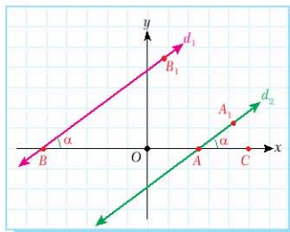
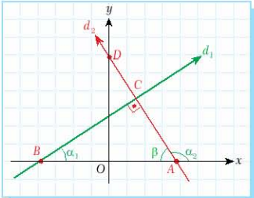


Parallel and Perpendicular lines

Slide 5
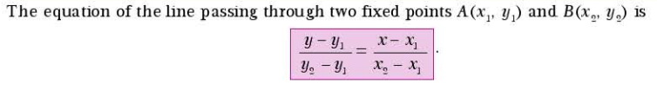
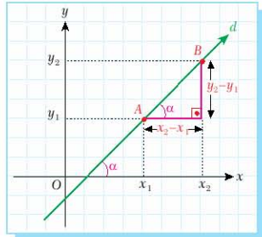
Equation of a line on the plane

Slide 6
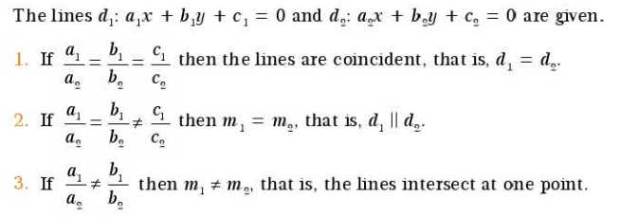
Relative position of two lines on the plane

Slide 7
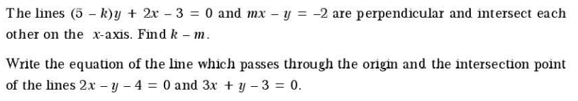
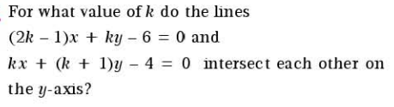
Practice

Slide 8

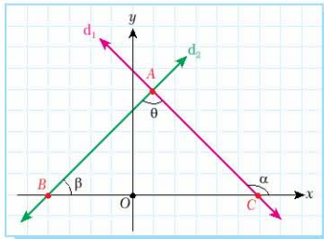

Angles between two lines

Slide 9
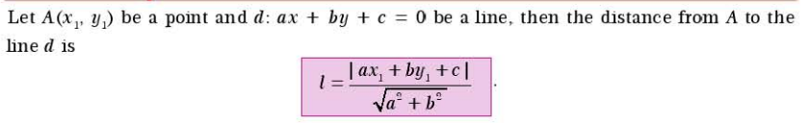
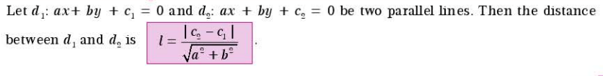
Distance from a point to a line

Slide 10
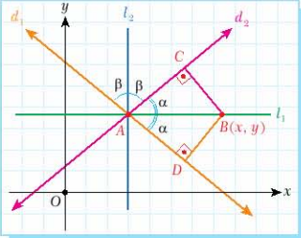

Equation of an angle bisector ( optional)

Slide 11

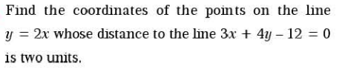
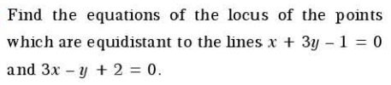
Practice

Slide 12
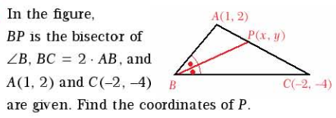
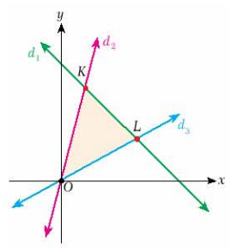

Practice 2

Slide 13
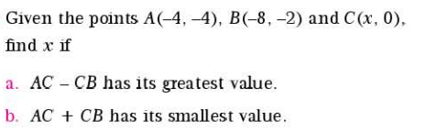


Practice 3

